Slide 1
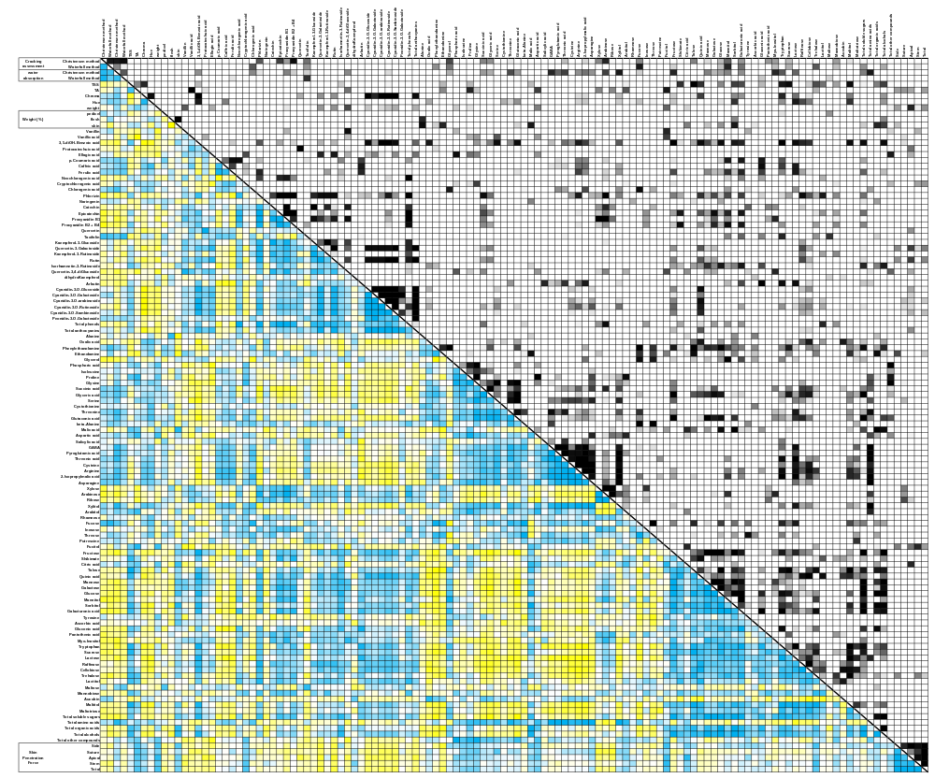
Spearman Correlation
P-Value
-0.8
0
0.8
0.001
0.01
0.05

